Slide 1
Optimizing Attitude Determination for Sun Devil Satellite – 1
Michelle Smith
Attitude Control Subsystem

Slide 2
Topic Overview
Attitude Control System
Quaternion Parameterization
Kalman Filter Application
Results of Implementation

Slide 3
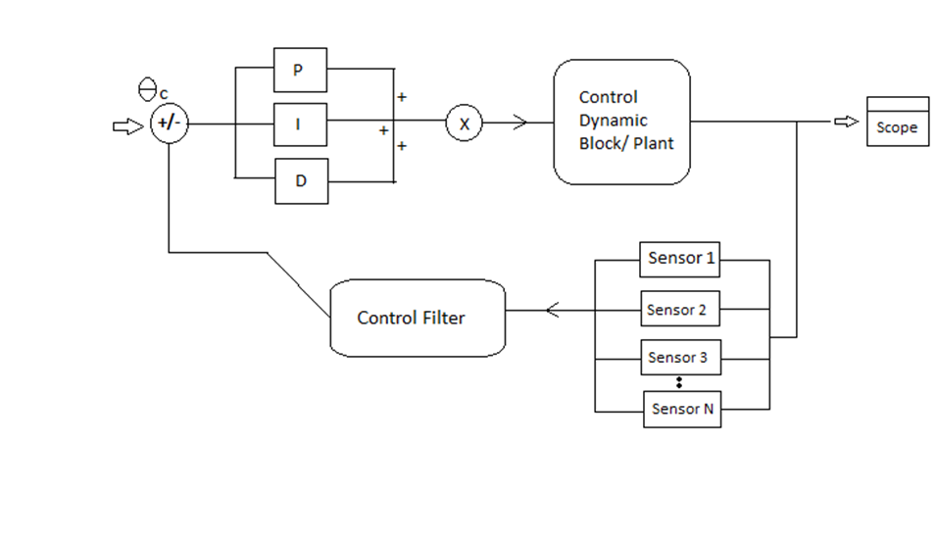
Attitude Control System
Essentially comprised of…
  Sensors—
        magnetometer
        fine sun sensor
        course sun sensors (photodiodes)
        inertial measuring unit
  Actuators—
        reaction wheels
        magnetorquers
  Associated Errors and Inaccuracies
Simplified Attitude Control System Model

Slide 4
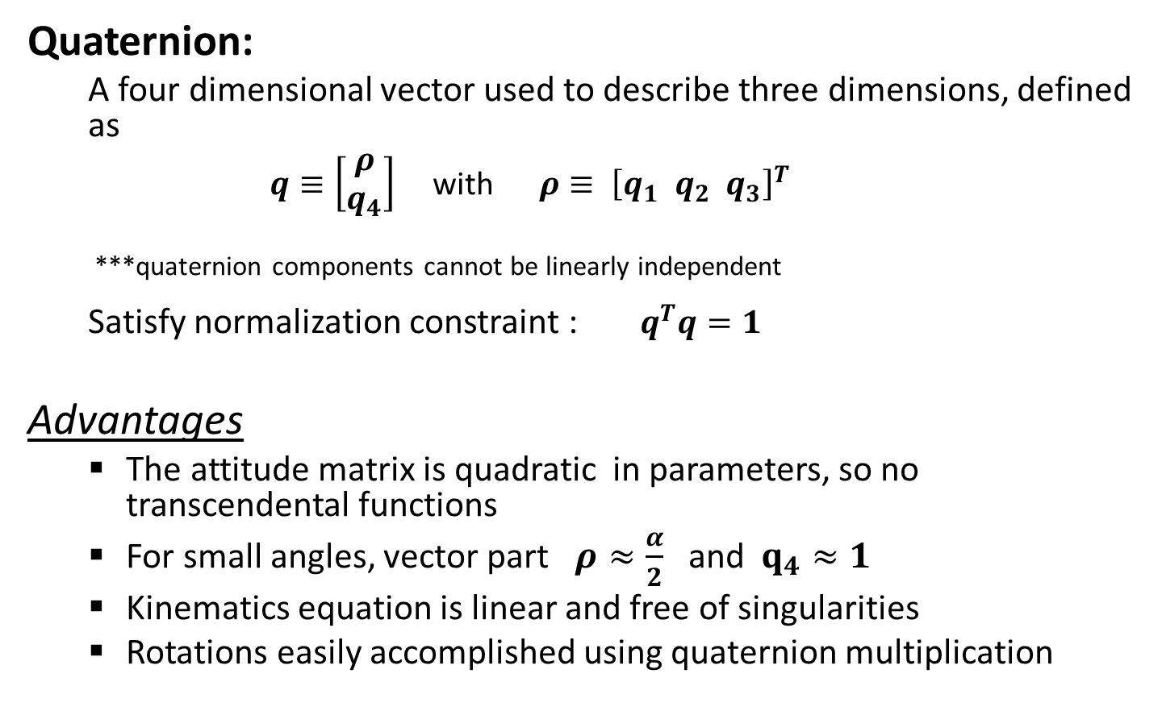
Parameterization
Quaternion:
  A four dimensional vector used to describe three dimensions, defined as
  $q≡\left[\begin{aligned}ρ \\ q_{4}\end{aligned}\right]$ with $ρ≡ {\left[q_{1}{ q}_{2}{ q}_{3}\right]}^{T}$
  ***quaternion components cannot be linearly independent
  Satisfy normalization constraint : $q^{T}q=1$
Advantages
  The attitude matrix is quadratic in parameters, so no transcendental functions
  For small angles, vector part $ρ≈\frac{α}{2}$ and $q_{4}≈1$
  Kinematics equation is linear and free of singularities
  Rotations easily accomplished using quaternion multiplication

Slide 5
Kalman Filter Application
Kalman Filter: recursive algorithm which produces an optimal estimation of a system state from noisy input data
Can be thought of as…
    Collection of Subroutines
              Initialize
              Gain
              Update
              Propagation

Slide 6
Kalman Filter Application
ROUTINE
The filter is initialized with a known state and error covariance matrix [attitude errors]
Kalman gain computed using measurement error covariance and sensitivity matrix
Updates and the quaternion renormalized
Estimates angular velocity used to propagate quaternion kinematics model and standard error covariance in the Kalman Filter

Slide 7
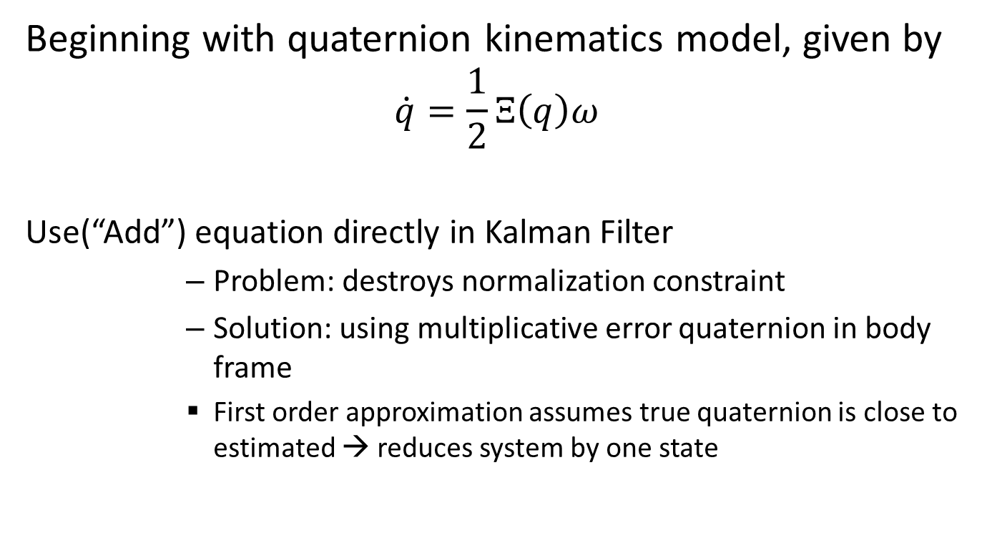
Kalman Filter Application
Beginning with quaternion kinematics model, given by
$$\dot{q}=\frac{1}{2}Ξ\left(q\right)ω$$
Use(“Add”) equation directly in Kalman Filter
      Problem: destroys normalization constraint
      Solution: using multiplicative error quaternion in body frame
      First order approximation assumes true quaternion is close to estimated → reduces system by one state

Slide 8
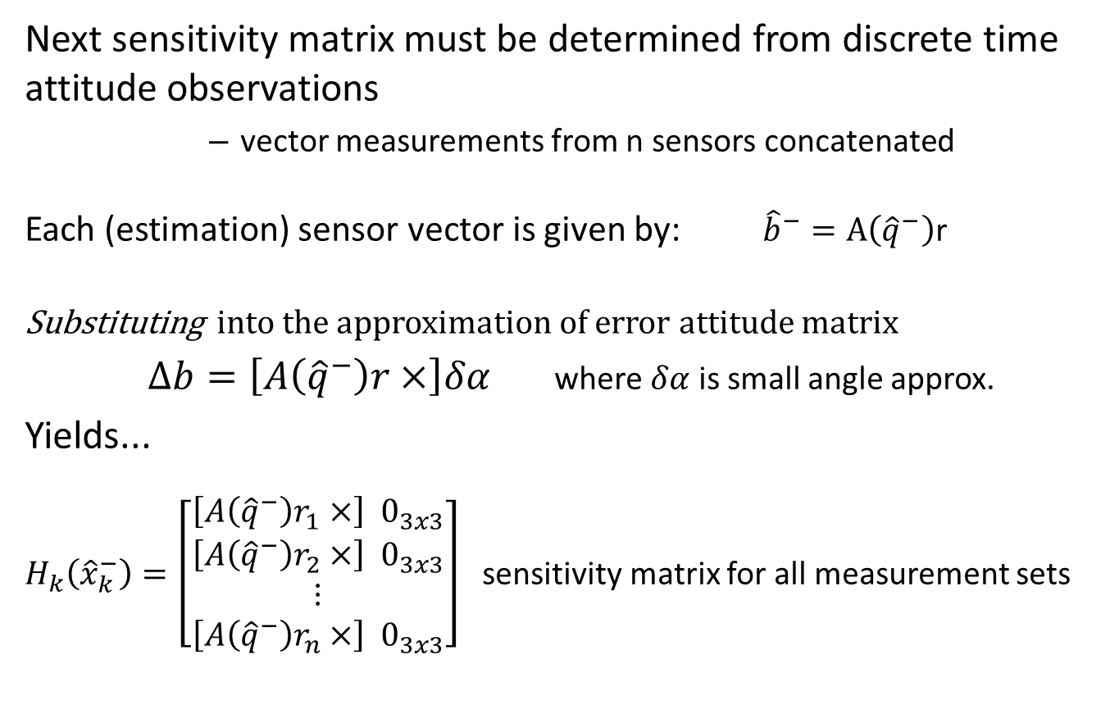
Kalman Filter Application
Next sensitivity matrix must be determined from discrete time attitude observations
      vector measurements from n sensors concatenated
  Each (estimation) sensor vector is given by: ${\hat{b}}^{−}=A\left({\hat{q}}^{−}\right)\text{r}$
Substituting into the approximation of error attitude matrix
$∆b=\left[A\left({\hat{q}}^{−}\right)r×\right]δα$ where $δα$ is small angle approx.
Yields...
$H_{k}\left({\hat{x}}_{k}^{−}\right)=\left[\begin{matrix}\begin{aligned}\left[A\left({\hat{q}}^{−}\right)r_{1}×\right] 0_{3x3} \\ \left[A\left({\hat{q}}^{−}\right)r_{2}×\right] 0_{3x3}\end{aligned} \\ ⋮ \\ \left[A\left({\hat{q}}^{−}\right)r_{n}×\right] 0_{3x3}\end{matrix}\right]$ sensitivity matrix for all measurement sets

Slide 9
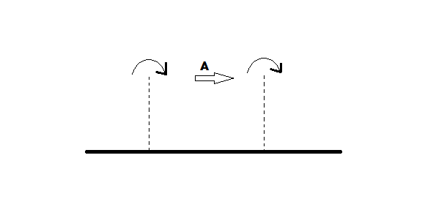







Kalman Filter Application
Finally → the error-state and quaternion update
Error State Update:
$∆{\hat{x}}_{k}^{+}=K_{k}\left[{\tilde{y}}_{k}−h_{k}\left({\hat{x}}_{k}^{−}\right)\right]$
${\tilde{y}}_{k}$ measurement output
$h_{k}\left({\hat{x}}_{k}^{−}\right)$ estimate output
$K_{k}$ Kalman gain
          Quaternion Update:
          ${\hat{q}}_{k}^{+}={\hat{q}}_{k}^{−}$ + $\frac{1}{2} Ξ\left({\hat{q}}_{k}^{−}\right)δ{\hat{α}}_{k}^{+}$
          ***renormalization should be performed to insure unity
$${\hat{x}}_{k−1}^{−}$$
$${\hat{x}}_{k−1}^{+ }$$
$${\hat{x}}_{k}^{−}$$
$${\hat{x}}_{k}^{+ }$$
$$t_{k−1}$$
$$t_{k}$$
Showing Recursive Property of Kalman Filter

Slide 10
Expected Results of Implementation
Implementation still in progress…
Qualitative Results
  By introducing the Kalman Filter into Sun Devil Satellite-1’s control system, attitude determination is expected to be optimized
    Increased accuracy with minimal additional computational burden
Quantitative Results
  How will it be tested?
  Simulation
    Reference attitude matrix (true attitude)
    Introduce Gaussian noise
    Compare outputs from attitude simulation
      without Kalman Filter
      with Kalman Filter
      actual/reference attitude
  Ensure quaternion normalization
Quaternion Normalization Results

Slide 11
Questions or Comments?
Name: Michelle Smith
Website: http://sdsl.club.asu.edu/
Email: sdsl@asu.edu
or msmith28@asu.edu

